Slide 1
Successful JavaEE DevOps in the Cloud
Derek Ashmore
Daniel Mohnen
Scott Kramer

Slide 2



About the speakers
Derek C. Ashmore, Architect and Author
“Microservices for Java Architects”
“Java EE Architect’s Handbook”
Plays classical piano
Daniel Mohnen, Principal Engineer @ Arity
27 years experience
Experience in distributed systems and mobile
Volunteers for local Java User Group
Scott Kramer, Lead “Hands-On” Architect
26 years experience
Presented at JavaOne, DevNexus, JavaZone, CoderConference
Volunteers for many organizations and loves construction

Slide 3
The Story
Arity is a new technology, data and insights startup founded by Allstate
Arity analyzes data and adds value by drawing meaningful insights from it
Arity takes information from a variety of sensors and sources coupled with the most accurate algorithms in the market to help our partners manage their risk

Slide 4
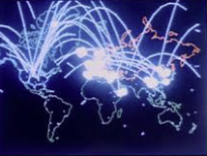
Agenda
Due to time constraints,
hold questions until the end
Tech Directions
Change is your friend
Design Scalable App
Concepts
Explore Ref App
Patterns and frameworks
HandsOn!
Learn and win stuff
Notes:
4 Sections

Slide 5

Technology Directions
What technologies you need to understand.
Derek

Slide 6

Why DevOp’s and Cloud?
Technical Answer
Scalability
Environment consistency
Deployment automation
Continuous delivery
Microservices
Business Answer
Speed to market
Change with lower risk
Higher availability
Cost effectiveness

Slide 7

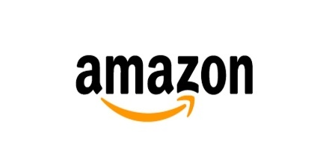

Stats from the field
GE Oil & Gas (source)
Delivery speed increased 77%
Cost of ownership decreased 52%
Better user experience
Amazon
One deployment per second!
Easily handle usage spikes with less waste
Web-site performance
Netflix
5300 deployments / day
Practice failure in production!
Streaming performance

Slide 8
The Cloud
What is it?
Virtual computing/networking
No hardware purchases
Secure access
Leverage R&D of vendors
Performance
World-wide presence
Why use it?
Speed to market
Cost effectiveness
Providers
AWS – market leader; broadest and most mature offering
Microsoft Azure – market second; offering gaining breadth and depth
Google – Good alternative to AWS, needs more robust features
Oracle and IBM Blue Mix –new players in the crowded cloud market
Top concerns
Security
Reliability (Google “CRN 10 biggest cloud outages”)
Notes:
QQ: What is Secure Access….

Slide 9

Micro-Services Architecture
“The microservice style of architecture is not so much about building individual services so much as it is making the interactions between services reliable and failure-tolerant”
– Josh Long
.
Distributed architecture
Loosely-coupled services
Data isolation
No distributed transactions
REST based
Fault-Tolerant
Elastic (horizontally scalable)
Cloud native
Notes:
Distributed Architecture
Loosely-coupled Services designed around Business Capability
Data Isolation
No Distributed Transactions
REST based Services
Fault-Tolerant
Elastic (Horizontally scalable)
Performant

Slide 10
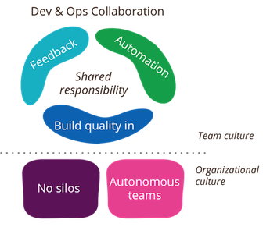
Competing Interests Problem
“Speed to Market” and “Reduced Risk of Change” work against each other
Development and Operations share end-goal but own different parts of the solution
DevOps == Development and Operations working together.
Need the right culture and management support to make it work
Notes:
Variables… Process(es) → Deploy Frequency → → Risk (more chg?)
Autonomous Teams, Feedback, Automation
Frequently tried without full participation of all related groups (testing, development, operations,
A fundamental principle of DevOps is to treat infrastructure the same way developers treat code. Aka build is repeatable and reliable. Example is JSON use for CloudFormation?
Development needs Change → Change is required to fix problems, serve customers
Operations need Stability → Change is the enemy of stability

Slide 11
The Rapid Rise of the Virtualization
Platform independence needs gave rise to Docker
Build once – run anywhere!
Cloud vendor / host independent
Decouples developers from operations
Developers control their environment (Jdk 7, 8, 9)
Operations only supports/deploys Docker images
Coordination needs: Disk, Memory, Ports, Cluster size
Virtual data centers
Managing scaling and running services on Docker
Cloud agnostic
No Cloud vendor lock-in
Cloud Foundry, Kubernetes, Apache Mesos / Marathon
Notes:
How many have used Virtualization like Vmware, Parallels, Fusion, etc.
Platform independence needs gave rise to Docker.
Docker can be run locally or in the cloud facilitating reliable development.
Docker has built in features that allow it start multiple containers simultaneously or in order, and can manage its own networking within containers and externally.
Docker buildfiles are used to create images which in turn can be instantiated (called a containers) which run on a host OS.

Slide 12
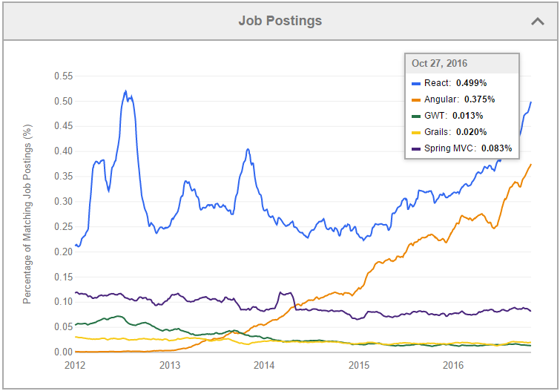
Single Page Application (SPA)
Break user interfaces into smaller pieces
User Interfaces can be monolithic too
Angular JS Framework
HTML5, CSS3
Interacts seamlessly with REST API
Responsive behavior via Twitter Bootstrap
React (with companion React-Native)
Effective Web, Android and i/OS applications
Same programming language for website and phone
Notes:
React and Angular seem to be the most in-demand web frameworks at the moment.
Advantages Easier to build and Maintain Responsive Application, best utilization of REST and highly scalable/available applications.
disadvantages of potential model duplication, JavaScript memory issues, and business logic in JavaScript.

Slide 13

Design a Highly Scalable App
Dan
Concepts required to build a Highly Scalable Application

Slide 14

Concepts
Resilience
Rule of 3
Region (country) and Zone (data center) independence
Failover pattern (Hardware vs. Software)
Dynamic & Proformant
Deploy in DevOps manner
Highly scalable (Stateless)
Monitoring
Data provenance
Operational
Layers
Edge; Middle; Back-end
Independence
Notes:
Resilience (aka Fault Tolerance)
Dynamic
Operational (Performance, etc)
GeoLatency Based Routing & RTE 53 Points of Presence
CloudWatch can reboot etc
Break into domains
Loosly Coupled verticals with isolated persistence
AWS ELB is also a traditional proxy-based load balancing solution whereas with Eureka it is different in that the load balancing happens at the instance/server/host level.
While you can theoretically put your mid-tier services behind the AWS ELB, in EC2 classic you expose them to the outside world and there by losing all the usefulness of the AWS security groups.
Another important aspect that differentiates proxy-based load balancing from load balancing using Eureka is that your application can be resilient to the outages of the load balancers, since the information regarding the available servers is cached on the client. This does require a small amount of memory, but buys better resiliency.

Slide 15
Gateway Layer
BROWSER SERVICE DEVICE ETC
CONSUMING APPLICATION
LB
Security
Gateway
Routing & Filtering
IN-MEM
Simplifies interaction between clients and servers
Handles Routes to Edge Layer
Central small well-defined surface provides:
Solves CORS problem
Centralization and control
Routing, Filtering, Throttling, Management
Security
Monitoring
Handles Persistence
EDGE
SERVICE
DB
FAILOVER
SERVICE DISCOVERY*
MIDDLE
SERVICE
DB
FAILOVER
Notes:
Cross-origin resource sharing (CORS) is a mechanism that allows restricted resources (e.g. fonts, JavaScript, etc.) on a web page to be requested from another domain outside the domain from which the resource originated.
Pre-Configured LB endpoints
Can be separated into EDGE and MIDDLE Tier
AWS ELB is also a traditional proxy-based load balancing solution whereas with Eureka it is different in that the load balancing happens at the instance/server/host level.

Slide 16
Edge Layer
BROWSER SERVICE DEVICE ETC
CONSUMING APPLICATION
Security
Gateway
Routing & Filtering
IN-MEM
Exposed external API’s
Resilient, Proformant
Horizontally Scalable
Stateless
Typically found by DNS
External Configuration
Service Discovery*
EDGE
SERVICE
SERVICE
DISCOVERY
DB
DB
FAILOVER
FAILOVER
SERVICE DISCOVERY*
MIDDLE
SERVICE
DB
FAILOVER
Notes:
The communication technology could be anything you like. Eureka helps you find the information about the services you would want to communicate with but does not impose any restrictions on the protocol or method of communication. For instance, you can use Eureka to obtain the target server address and use protocols such as thrift, http(s) or any other RPC mechanisms.

Slide 17
Middle Layer
BROWSER SERVICE DEVICE ETC
CONSUMING APPLICATION
Security
Gateway
Routing & Filtering
IN-MEM
Security Enhanced
Cached References
Resilient to LB failure
Health Monitoring
Layer Load Balanced
Protocol Independent
EDGE
SERVICE
DB
FAILOVER
SERVICE DISCOVERY*
MIDDLE
SERVICE
DB
FAILOVER
Notes:
Exposing Middle Services voids benefits of AWS security groups.
Proxy based is resilient to Load balancer outages; different from normal load balancing

Slide 18
Microservice Cloud Architecture
BROWSER SERVICE DEVICE ETC
CONSUMING APPLICATION
LB
Security
Gateway
Routing & Filtering
IN-MEM
EDGE
SERVICE
DB
FAILOVER
SERVICE DISCOVERY*
MIDDLE
SERVICE
DB
FAILOVER
Notes:
Gateway can be any combination – Layer7, Apigee, SSO, oAuth, Certificates,?
Opinionated; Should Prefer REST, but other protocols supported
Cloud Native; You can use any provider (Azure, Google, AWS) or container (AMI, Docker, Elastic
AWS Rule of 3
Gateway Service vs. Edge Service vs. Back-End Service

Slide 19

Deployment
Machine Creation
Mutable, Immutable
Continuous Deployment
Use a Template
Popular Tools
Jenkins
Spinnaker
Asgard
Chef, Puppet, Ansible
Deployadactyl
Even can use scripting (ex: Python, shell scripts, etc)…
Commit to Source Code Control
Auto Build & Test & Artifacts
Monitor &
Manage
Deploy

Slide 20
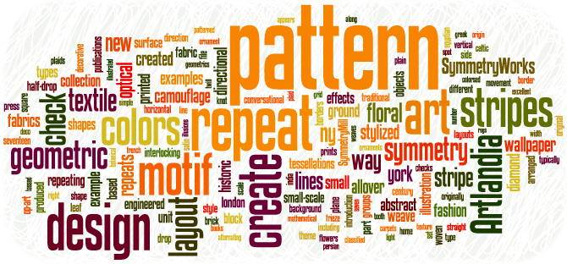
ReferenceApp Design Details
Scott
Exploring the Reference Application Specifics

Slide 21
ReferenceApp Architecture
BROWSER SERVICE DEVICE ETC
ANGULAR & REACT
LB
SSO
Gateway
ZUUL
REDIS
DEVICE
UI
ADMIN
UI
HYSTRIX
TURBINE
UI
GRAPHITE
METRICSUI
DB
DB
HYSTRIX
HYSTRIX
DB
DB
EUREKA SERVICE REGISTRY*
DEVICE
SERVICE
ADMIN
SERVICE
DB
DB
HYSTRIX
HYSTRIX

Slide 22

Bootable JAR (Spring Boot & JavaEE)
Leading product for producing application jars
Tooling to quickly/simply standup an application
Trade-off is automated dependencies included
Developers provide
Application class with optional code config
Configuration file application.properties
Notes:
Tooling to quickly/simply standup an application by setting up the config and all the plumbing.

Slide 23
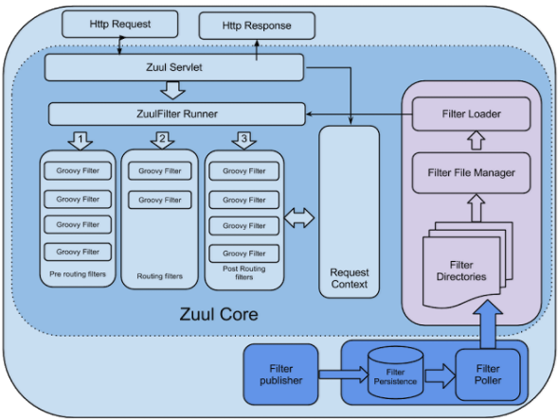
Netflix Zuul
Transaction Cross-cutting concern logic
Like a dynamic servlet filter
Written in groovy, can be changed without re-deployments
Spring Cloud has annotations leveraging Zuul
Use Cases -- Combine with
Spring Cloud -> Route transactions to services
Hystrix -> outage protection
Eureka -> Canary release support and gradual deployments
Turbine -> Detailed CB metrics
Notes:
Timing – How much does it add? Does it work with CF – and add a WHY sections & Drawbacks
#PRE filters execute before routing to origin. Examples include request auth, choosing origin servers, and logging debug info.
#ROUTING filters handle routing the request to an origin. This is where the origin HTTP request is built and sent using Apache HttpClient or Netflix Ribbon.
#POST filters execute after the request has been routed to the origin. Examples include adding standard HTTP headers to the response, gathering statistics and metrics, and streaming the response from the origin to the client.
#ERROR filters execute when an error occurs during one of the other phases.

Slide 24

Authentication
In the real world
Authentication is handled by an LDAP-like product
OpenLDAP, Active Directory, etc.
Security and user information managed by SSO product
OpenAM, Okta, etc.
Spring Security can integrate with these
Reference App Usage
Spring Security backed by Spring Session using REDIS
Not backed by database or a security application
Don’t do this at home! It’s not production worthy

Slide 25
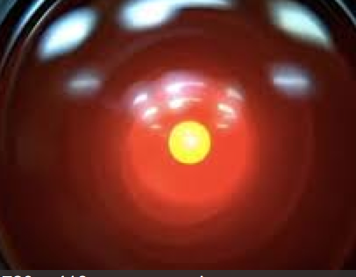
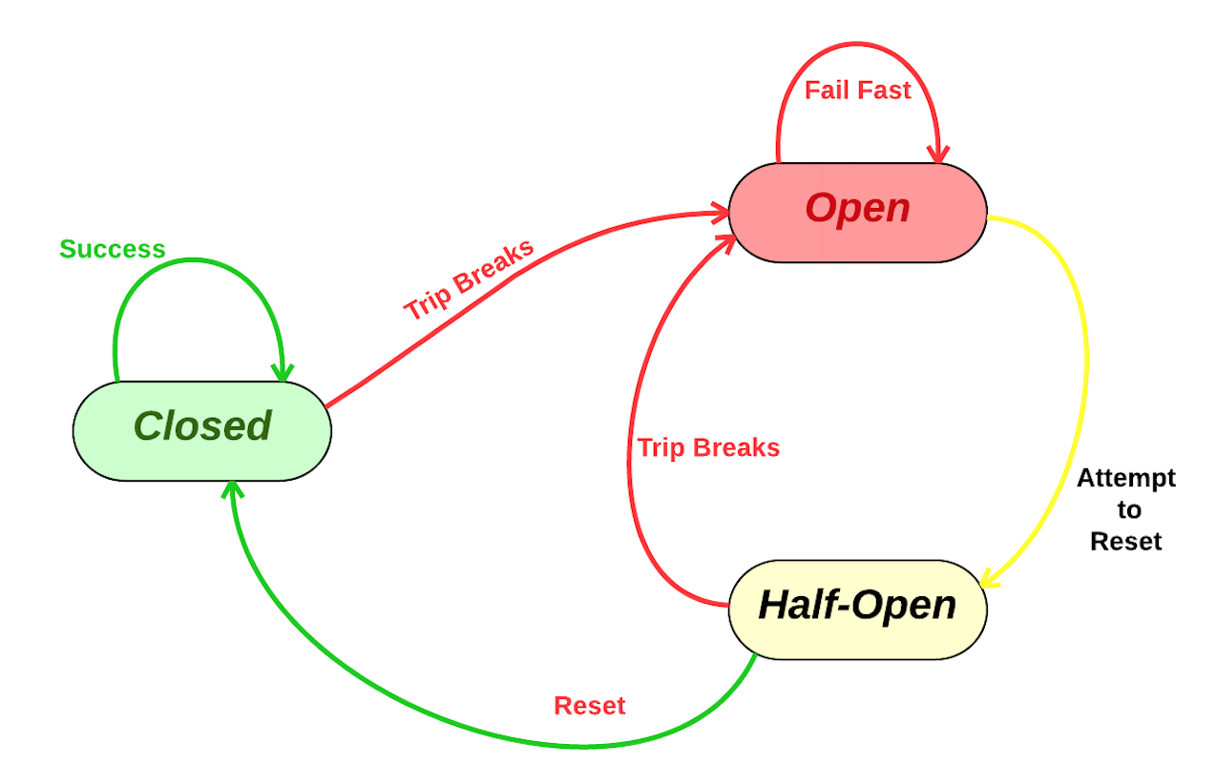
Circuit Breaker: Netflix Hystrix
Circuit Breaker Pattern (aka Failover Pattern)
Like a circuit in your house
Spring Cloud provides convenience annotations for the Hystrix Circuit Breaker
Reference App Usage -> Device-Service & Device-UI

Slide 26

Eureka Service Registry & Discovery
Like a “phone book” for your microservices
Mid-tier load balancing & health monitoring
Each service registers itself with registry with info
example: host, port, node name
Eureka Client is used by edge services to find back end services
Reference App Usage
Gateway, device-service

Slide 27
Dropwizard
Dropwizard
Metrics API implemented in many of the toolsets we’re using (Spring, Eureka, Zuul, Hystrix, etc.).
Monitoring data for health and performance
Healthcheck API
Eureka, Zuul, Hystrix (plus all Netflix products)
Produces Application jars (like Spring Boot)
Reference App Usage
Admin-ui -> Produces Application jar and Healthcheck
All use metrics via companion products

Slide 28
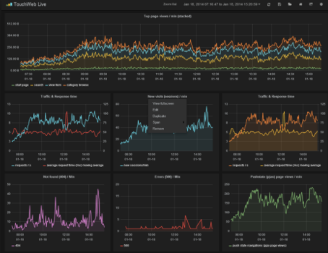
Graphite
Enterprise Monitoring tool that runs equally well on cheap hardware or Cloud infrastructure
Store, retrieve, share, and visualize time-series data
Works with Dropwizard Metrics

Slide 29

HandsOn Workshop
Understanding, Using, Coding the Front End Application
“Talk is cheap, Show me the Code” – L. Torvalds
Derek
Dan
Scott
Notes:
THIS SLIDE AND FOLLOWING SLIDES REMOVED IF --NOT-- A “HANDS-ON” PRESENTATIONS
THIS SLIDE AND FOLLOWING SLIDES REMOVED IF --NOT-- A “HANDS-ON” PRESENTATIONS
THIS SLIDE AND FOLLOWING SLIDES REMOVED IF --NOT-- A “HANDS-ON” PRESENTATIONS
THIS SLIDE AND FOLLOWING SLIDES REMOVED IF --NOT-- A “HANDS-ON” PRESENTATIONS
THIS SLIDE AND FOLLOWING SLIDES REMOVED IF --NOT-- A “HANDS-ON” PRESENTATIONS
THIS SLIDE AND FOLLOWING SLIDES REMOVED IF --NOT-- A “HANDS-ON” PRESENTATIONS

Slide 30
Housekeeping
Beginner
Making this as simple as possible was the design goal
It does sacrifice good design principles
Don’t use in production!
Spare USB’s with VirtualBox image
VirtualBox image password:
Start up the image and get it setup
Click on Applications
Click on Terminal
Load the project by typing:
debian
ra
Notes:
How to put the sausage in the casing, not how to harvest ingredients, prepare them, and cook them.

Slide 31
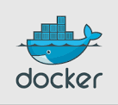
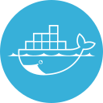
Docker KEY Points Refresher
Beginner
Built in features of:
Network & Port Management (NAT)
Docker images are virtual machines
Docker images can be instantiated in a container which runs on the host OS (locally or cloud)
Notes:
How many have used Virtualization like Vmware, Parallels, Fusion, etc.
Platform independence needs gave rise to Docker.
Docker can be run locally or in the cloud facilitating reliable development.
Docker has built in features that allow it start multiple containers simultaneously or in order, and can manage its own networking within containers and externally.
Docker buildfiles are used to create images which in turn can be instantiated (called a containers) which run on a host OS.

Slide 32
Lesson 1 – Docker run redis
Beginner
In the cloud, unlike a normal local machine, Docker runs natively on the Operating System
Normally you must docker pull an image from repository
Docker commands are entered at a command line level, and always begin with docker keyword
On your machine Click “Activities” then “Terminal”
docker ps –a # shows all running containers and ports
docker run [-flags] [image-name]
-d # run in detached status
-p “3333:7777” # 3333 is external exposed port and 7777 is internal port
docker run –d –p “6379:6379” redis

Slide 33
Lesson 2 – Docker run graphite
Beginner
You got it
Start Graphite (GUI and Service)
Image name is sitespeedio/graphite
GUI Ports: Internal 8780 exposed as 80
Service Ports: Internal 2003 exposed as 2003
docker run -p "8780:80” –p "2003:2003” sitespeedio/graphite

Slide 34
Lesson 3 – Starting the App
Beginner
On VirtualBox click “Activities” and “IntelliJ”
In this design the Gateway service must be started first
The Gateway is used to route consuming application traffic
On the bottom area locate the Gateway and click RUN button
Service-Registry is started next
Service-Registry allows edge services to find backend services
Eureka allows services to register with the Eureka Server
Allows dynamic service registration, health, load balancing, and use
On the bottom area locate the Service-Registry and click RUN button
Start all remaining services (any order)
Chrome to http://localhost:8080/
Navigate to DEVICE section

Slide 35
Hystrix KEY Points Refresher
A Circuit Breaker method has at least 2 paths
FIRST: Normal Route to call another method/service
SECOND: Fail Route to call if Normal Route Fails
Hystrix Syntax
@HystrixCommand(fallbackMethod = ”methodName")
public void myMethod(..) {…
HYSTRIX
Normal
DEVICE-SERVICE
DEVICE
UI
DB
Failover
FAILOVER…
HYSTRIX

Slide 36
Lesson 4 – Hystrix Circuit Breaker
Intermediate
Where are Circuit Breaker Patterns implemented?
TASK: What actions cause it to “activate”?
HINT: @HystrixCommand(fallbackMethod = ”methodName")
TASK: Try to make it activate.
Edit/ Find/ Find in Path/ fallbackMethod
Stop device-service causes resilient

Slide 37
Lesson 5 - ZUUL
LB
Routing Service has predefined Service Names
Service configured in the application.yml file
Clients use a .yml file to tell ZUUL there name
Challenge
Where is ZUUL code for Configuring DEVICE-UI name
Is a Configuration needed for DEVICE-SERVICE?
Gateway
ZUUL
Security
IN-MEM
Notes:
Cross-origin resource sharing (CORS) is a mechanism that allows restricted resources (e.g. fonts, JavaScript, etc.) on a web page to be requested from another domain outside the domain from which the resource originated.
Pre-Configured LB endpoints
Can be separated into EDGE and MIDDLE Tier
AWS ELB is also a traditional proxy-based load balancing solution whereas with Eureka it is different in that the load balancing happens at the instance/server/host level.

Slide 38



Questions?
Notes:
THIS SLIDE AND FOLLOWING SLIDES REMOVED IF --NOT-- A “HANDS-ON” PRESENTATIONS
THIS SLIDE AND FOLLOWING SLIDES REMOVED IF --NOT-- A “HANDS-ON” PRESENTATIONS
THIS SLIDE AND FOLLOWING SLIDES REMOVED IF --NOT-- A “HANDS-ON” PRESENTATIONS
THIS SLIDE AND FOLLOWING SLIDES REMOVED IF --NOT-- A “HANDS-ON” PRESENTATIONS
THIS SLIDE AND FOLLOWING SLIDES REMOVED IF --NOT-- A “HANDS-ON” PRESENTATIONS
THIS SLIDE AND FOLLOWING SLIDES REMOVED IF --NOT-- A “HANDS-ON” PRESENTATIONS

Slide 39
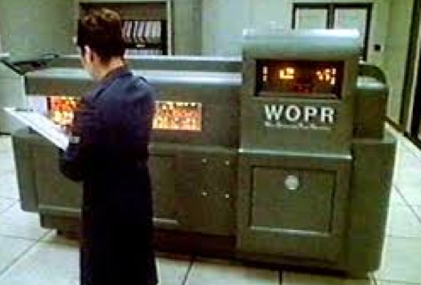
Build Automation Example – Maven/Docker
Maven Plugins: Custom maven Plugins to fully automate CI, Integration Tests, Building Containers, Publishing to Repository, deployment to Cloud, Static and Dynamic Scans.
Docker Maven Plugin
<plugin> <groupId>com.spotify</groupId> <artifactId>docker-maven-plugin</artifactId> <version>0.2.3</version> <configuration> <imageName>${docker.image.prefix}/${project.artifactId}</imageName> <dockerDirectory>src/main/docker</dockerDirectory> <resources> <resource> <targetPath>/</targetPath> <directory>${project.build.directory}</directory> <include>${project.build.finalName}.jar</include> </resource> </resources> </configuration> </plugin>
clean package docker:build -DpushImage

Slide 40
Build Automation Example – AMI/Debian/Docker
Machine Creation…
aws ec2 run-instances --image-id ami-92d6adf8 --count 1 --instance-type t2.micro --key-name KeyPairName --security-groups default --user-data file://bashfile.sh
bashfile.sh…
#!/bin/bash
sudo apt-get update
sudo apt-get -y install apt-transport-https
sudo apt-key adv –keyserver
hkp://p80.pool.sks-keyservers.net:80 --recv-
keys58118E89F3A912897C070ADBF76221572C52609D
cat <<EOF >/etc/apt/sources.list.d/docker.list
deb https://apt.dockerproject.org/repo debian-jessie
main
EOF
sudo apt-get update
sudo apt-get install –y –force-yes docker-engine
sudo service docker start
docker login -u DOCKER_USER -p DOCKERPWD –e email
docker pull owner/image
docker run .....
Notes:
Debian based

